Slide 1
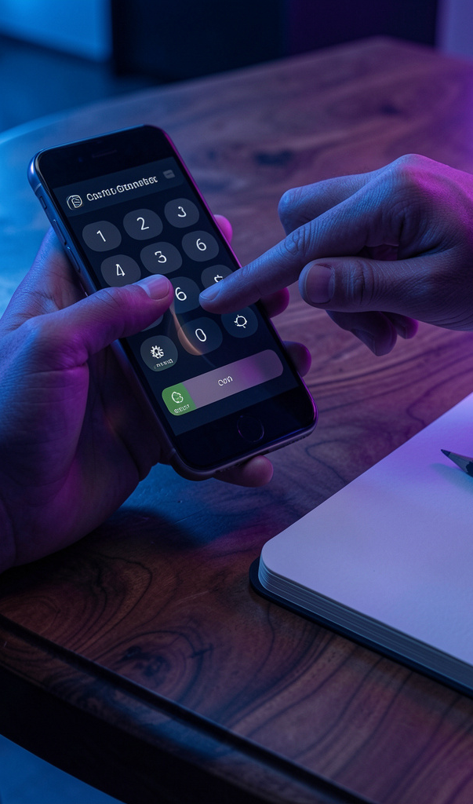
Mobile UI/UX
NAME: Tapan Patel
Enrollment No.: 12302080601119
Class: IT1 (C8A)

Slide 2
UI vs UX
UI is the visual and interactive layer: colors, typography, buttons, inputs, and how users tap or type. UX is the end-to-end journey and value users gain, from signing up to completing a task with minimal friction. Example: a login screen shows the UI—fields, a primary button, icons; the UX depends on sign-in speed and clear error messages. A good UX makes the flow fast and forgiving; a poor UX hN

Slide 3
Good UX Wins
A clear primary CTA and legible text guide users instantly to complete tasks. One-tap checkout reduces effort and supports quick decisions, keeping carts from abandoning.
Hidden CTAs, tiny text, and multi-step checkout create friction and confusion. These frictions increase drop-offs and frustrate users during shopping.

Slide 4
UI vs UX
UI: Appearance & Interaction
UX: Goals & Flows
UI governs colors, typography, icons, button states, and spacing. It shapes first impressions and micro-interactions that feel responsive. It answers how the app looks and how it behaves at a glance.
UX covers user research, information architecture, user flows, and usability testing. It defines user goals, paths, and task efficiency. A beautiful UI onboarding screen still fails if the UX forces unnecessary steps—good products combine both.
UI and UX must work together.

Slide 5
Consistency & Clarity
Apply consistency across screens by reusing the same primary button color and style. Establish visual hierarchy with larger bold headlines for product name, then smaller secondary text like price. Aim for simplicity with a single primary action per screen, such as Add to Cart. Ensure readability with 16–18sp body text and strong contrast, spacing for touch targets ≥44px, and clear feedback through

Slide 6
Mobile Design Steps
Responsive
Touch Targets
Thumb Reach
Legibility
Platform Patterns
Graceful States
Design layouts that scale from small to large screens.
Use controls at least 44px and ample spacing for accuracy.
Place primary actions within the thumb’s reach (bottom or center).
Choose readable fonts with high contrast for accessibility.
Follow Android Material vs iOS Human Interface Guidelines for familiar patterns.
Plan loading, offline, and error states with skeletons and retry options.

Slide 7
UI/UX Process
01
02
03
04
User Research
Define Problems
Create Personas
Build User Flows
Interviews and analytics review to understand user needs and behavior.
Prioritize pain points to clarify what the product must solve.
Build representative user types to guide decisions.
Map tasks end-to-end to reveal paths and touchpoints.

Slide 8
UI/UX Process
Interviews and analytics review to understand user needs and patterns.
Research
Prioritize pain points to frame the design challenge.
Define
Create representative user types to guide decisions.
Personas
Map tasks end-to-end to reveal friction points.
Flows

Slide 9
Structure vs Interaction
Low-fidelity wireframes use simple sketches or greyscale blocks to test layout and flow quickly. They focus on information hierarchy, navigation paths, and content placement without getting hung up on visuals. Use paper or digital tools to iterate fast.
High-fidelity prototypes are pixel-accurate screens with interactive elements. They validate microcopy, animations, and usability in a realistic context, helping stakeholders feel the product.

Slide 10
Pick the right tool by task
Figma & FigJam
Sketch, XD, Canva
Figma: cloud-based interface design and prototyping with real-time collaboration. FigJam: whiteboard for brainstorming, flow mapping, and workshops.
Sketch: established macOS UI design with a rich plugin ecosystem. XD: prototyping and animation (availability/licensing varies). Canva: quick graphics, presentations, and simple mockups.

Slide 11
Clutter-Free UI
Common mistakes waste cognitive load: too many colors and fonts fragment the interface. Cluttered screens hide priorities; use progressive disclosure to reveal content as needed. Small touch targets reduce accuracy—raise to 44px and add spacing. Poor contrast breaks readability; meet WCAG 4.5:1 for normal text. Standardize navigation patterns and labels to avoid confusion.

Slide 12
Future UI Trends
User Goal
UI Principles
Prototype Test
Define the primary user goal for each screen.
Apply consistency, hierarchy, and spacing to guide decisions.
Validate flow with a low-fi prototype and 3–5 users.
Accessibility
Iterate & Measure
Ensure touch targets and contrast meet accessibility guidelines.
Iterate based on feedback and measure task completion time.

Slide 13
THANK YOU

